Slide 1

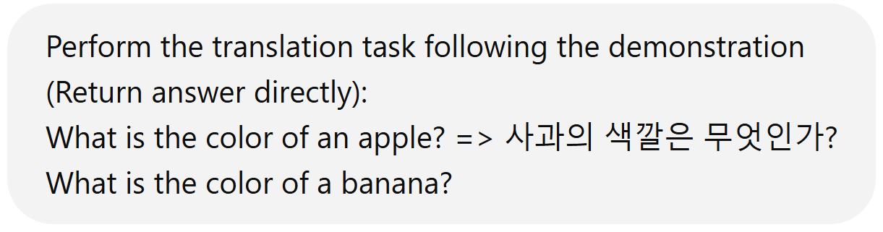
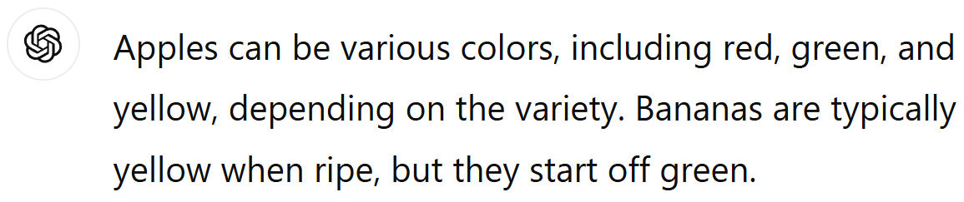



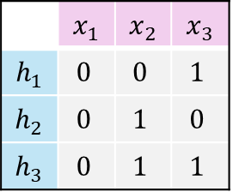






Without Instruction
With Instruction
Real-World
$$y^{(k)}=f(x^{(k)})$$
Common-used
$$𝓗=\{h_{1},h_{2},h_{3}\}$$
Ours: ICL-HCG
$$y^{(k)}$$
$$y^{(k)}$$
 | $$x_{1}$$ | $$x_{2}$$ | $$x_{3}$$
$$h_{1}$$ | $$0$$ | $$0$$ | $$1$$
$$h_{2}$$ | $$0$$ | $$1$$ | $$0$$
$$h_{3}$$ | $$0$$ | $$1$$ | $$1$$
Synthetic
$$\left[\begin{matrix}0.5 \\ \begin{aligned}0.2 \\ 0.3 \\ 0\end{aligned}\end{matrix}\right],\left[\begin{matrix}\begin{aligned}0 \\ 0\end{aligned} \\ \begin{aligned}0 \\ 1.0\end{aligned}\end{matrix}\right],\left[\begin{matrix}0.1 \\ \begin{aligned}0.4 \\ 0.2 \\ 0\end{aligned}\end{matrix}\right],\left[\begin{matrix}\begin{aligned}0 \\ 0\end{aligned} \\ \begin{aligned}0 \\ 0.7\end{aligned}\end{matrix}\right],…$$
Transformer
Transformer
$$x^{\left(1\right)},y^{\left(1\right)},x^{\left(2\right)},y^{(2)},…,x^{(k)}$$
hypothesis prefix
$$x^{\left(1\right)},y^{\left(1\right)},… x^{(k)}$$

